Slide 1
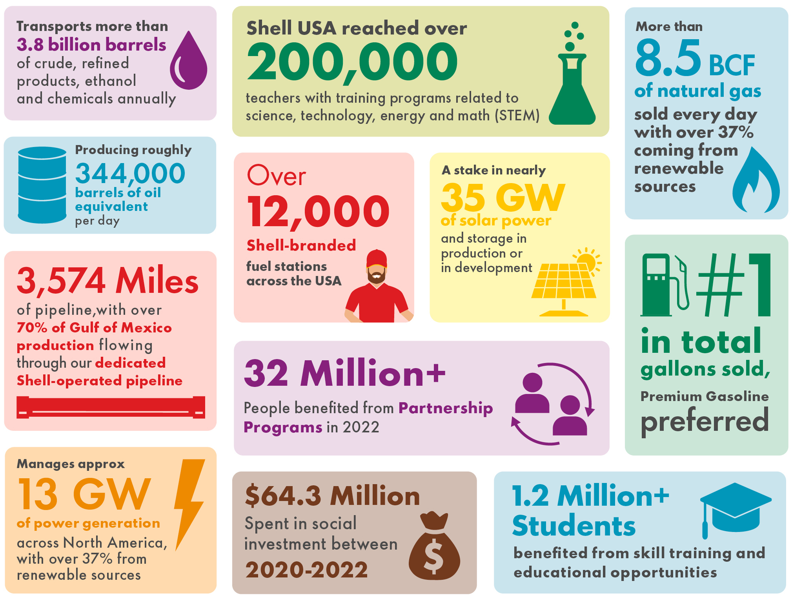
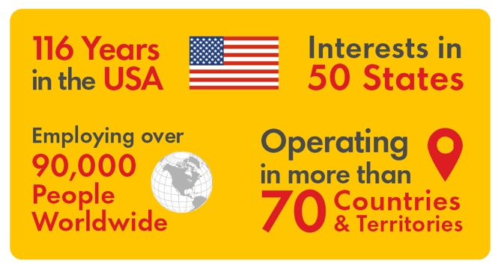
Shell in the United States
Country profile February 2024
Social investment
Powering Progress in the USA
Today, we are delivering more and cleaner energy across America – from producing a secure supply of oil and gas in the US Gulf of Mexico to renewable biofuels, to our expanding EV charging network, to electricity generated by solar and wind power. As the energy system continues its transformation, we are working with our customers and across sectors on the journey to net-zero emissions in the United States and globally. Shell believes we can deliver the energy the world needs today, while building the energy systems of tomorrow – all while creating value for society and our shareholders. To make progress, we believe everybody must experience the economic, social, and environmental benefits of a changing energy system.
Among the countries where Shell does business it’s the only one where every line of business is represented. We have called the US home for over 100 years, and we are proud to be part of the neighborhoods and towns where our Shell family lives and works. We strive to protect these places for today and for future generations.
2020-2022
$64.3 million including:
Education..................$22.9 million
Conservation...............$7.9 million
Taxes, royalties and fees
2022
Paid to governments in US¹..........................$6.65 billion
Research and development
2022
Public universities and other research partners.......$19.8 million
Staff counts
2022
Employees..........................12,700+
Retirees..............................31,200+
1 Paid or collected for the country/state. Various state tax credits are available for use in determining net state tax liability before applicable credits.
Most information contained in this information sheet is current as of February 2024. Certain numbers in this material are rounded.

Slide 2
Shell in the United States
Country profile February 2024
Upstream
Hydrogen
Operating the first three heavy-duty hydrogen truck refueling stations in California, moving freight from the ports of Los Angeles and Long Beach into Southern California
Offshore Wind (in development)
Two US leases with Atlantic Shores Offshore Wind, with capacity to generate 4.5 GW of wind energy off coasts of New Jersey and New York
Onshore Wind
A stake in onshore wind farms, providing power in California and Texas
Power
Shell Energy, launched in June 2022, provides 100% renewable electricity plans to consumers in Texas
Providing renewable power to commercial and industrial customers seeking to meet decarbonization goals
Manages more than 13 GW of power generation across North America, with over 37% from renewable sources
Solar
100% ownership of Savion, a solar developer based in Kansas City, with solar and storage facilities currently under development
Powering Shell operations with solar: 326 KW at Stockton Shell Oil distribution terminal; 300 KW at Shell Technology Center Houston
Mobility, Trading and Supply
Chemicals and Products
Total share of US production is 344,000 barrels of oil equivalent per day
Operating nine deep-water production hubs plus one non-operated and a network of subsea infrastructure
Over 20 field development projects with subsea production systems
One of the largest leaseholders in the U.S. Gulf of Mexico
Production is among the lowest GHG intensity in the world when compared to other IOGP (international association of oil and gas producers) O&G producing members
Retail
Over 12,000 Shell-branded fuel stations across 49 states, serving 8 million customers daily
Jiffy Lube®
Over 2,000 locations providing oil changes, tire rotations and other preventive vehicle maintenance²
Trading
Shell Trading (US) Company trades crude oil, refined products, low carbon fuels, chemical feedstocks, natural gas/LNG, electrical power, environmental products, biofuels and freight
Shell Energy North America
Trades and markets natural gas, wholesale and retail power, as well as environmental and risk management products
Natural gas sales volume of 8.5 billion cubic ft/day
300 million MWh – annual wholesale and retail power sales in North America
Consistently ranked one of top three gas and power marketers in North America
Midstream
Owns, operates, develops and acquires pipelines and other midstream and logistics assets
Owns and operates five crude and product storage facilities and eight caverns across the US
Own/operate 3,574 miles of pipeline
70% of Gulf of Mexico production flows through Shell-operated pipelines
Transports more than 3.8 billion barrels of crude, refined products, ethanol and chemicals annually
Refining
Shell Energy and Chemicals Park Norco – St. Charles Parish, LA: integrated refining and chemicals asset
Chemicals
Five chemical manufacturing facilities making materials that go into soaps, shampoos and household cleaning solutions, as well as plastics and building supplies
Convent Facility, St. James Parish facility planning underway to potentially repurpose facility as part of a hub for low carbon fuels and products, pending final investment decision
Shell Energy and Chemicals Park Norco – St. Charles Parish, LA
Geismar Chemical Plant – Ascension Parish, LA
Shell Polymers Monaca – Monaca, PA
Deer Park Chemicals – Deer Park, TX
Lubricants
Six plants where lubricants are blended and packaged for sale
Fowlerville, MI
Galena Park, TX
Newell, WV
River Rouge, MI
Tehachapi, CA
Wilmington, CA
Shell Catalysts and Technologies
Provides leading catalysts, technical services and licensed process technologies to refiners, gas treating facilities and chemical plants around the world
Martinez, CA
Michigan City, IN
Pittsburg, CA
Port Allen, LA
Renewables and Energy Solutions
Battery storage
Ownership of sonnen, a world-leading manufacturer of smart solar energy storage systems
Biofuels
Purchased stake in LanzaJet, which uses catalytic conversion to convert alcohol into aviation fuel, reducing emissions compared to conventional jet fuel
Shell New Energies Junction City using locally sourced cow manure and agricultural residues to produce biogas
Sustainable Aviation Fuel agreements signed with JetBlue, Alaska Airlines and Delta
Electric vehicle charging
Following the acquisition of Volta in March 2023, Shell owns more than 3,000 publicly available charge points in the US and Canada
2 Headquartered in Houston, Texas, Jiffy Lube® International, Inc. is a wholly owned, indirect subsidiary of Shell USA, Inc.
Disclaimer: In this information sheet, “Shell” and “Shell group” and are sometimes used for convenience where references are made to Shell plc and its subsidiaries in general. Likewise, the words “we”, “us” and “our” are also used to refer to subsidiaries in general or to those who work for them. These expressions are also used where no useful purpose is served by identifying the particular company or companies. “Subsidiaries”, “Shell subsidiaries” and “Shell companies” as used in this document refer to companies over which Shell plc either directly or indirectly has control. Most information contained in this information sheet is current as of February 2024. Certain numbers in this material are rounded.

